Slide 1
Developing an Environment for Reconfigurable Mesh Algorithms using Multi-Core Computers
Authors:
Daniel Laevski ID: 307575472
Nadav Inbar ID: 039063466
Supervisor:
Esti Stein, M.Sc

Slide 2
Outline
Introduction
Goal
Reconfigurable Mesh Model
How it works
Examples
Complexity
Related Work
Our Solution
Compiler Design
Compilation Process
Obstacles
Benefits and Future Plans
References

Slide 3
Introduction
The Reconfigurable Mesh (RM) serves as a theoretical model for massively parallel computing
RM has recently been investigated as a practical architecture for many-cores with light-weight, circuit-switched interconnects
As of today, there is a lack of learning environments for the RM, which include:
languages, programming environments, compilers, and debuggers

Slide 4
Goal
To provide a graphical environment for writing and running algorithms for RM
The environment will support: compiling (translating) the program, and run it with a graphical interface for a better debugging and understanding the RM flow
The environment will simulated the parallelism by running the algorithms in multi-threaded code

Slide 5
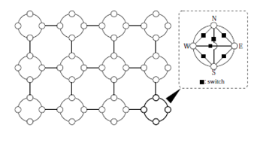
Reconfigurable Mesh Model
RM of size n x m consists of nm identical SIMD processors positioned on a rectangular array with n rows and m columns
All processing elements execute cycles of:
Bus configuration
Communication
Constant-time computation in a lock-step

Slide 6
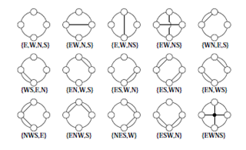
Reconfigurable Mesh – How does it work?
Mesh Architecture
Processing element (PE)
Connection autonomy, 15 possible patterns
Constant PE Computation time
Communication delay O(1)

Slide 7
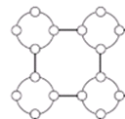
Reconfigurable Mesh – How does it work?
All processors work synchronously. A single step of an RM consists of the following 4 phases:
Read phase – receive data from a port
Calculation phase - execute constant-time local computations
Switch configuration phase - change the configuration of inner buses
Write phase - send data to a port

Slide 8
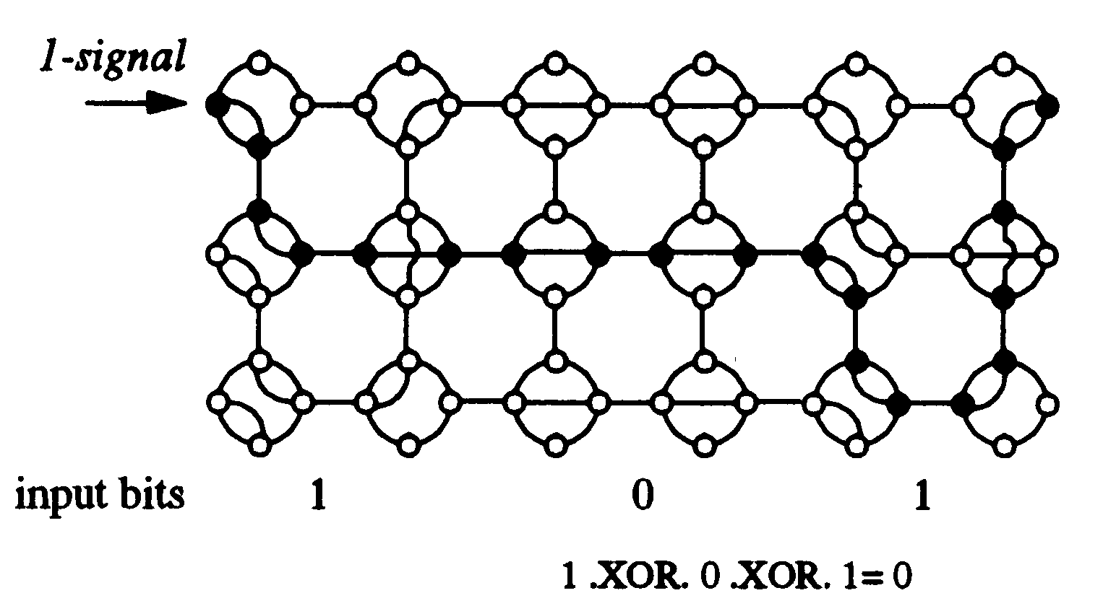
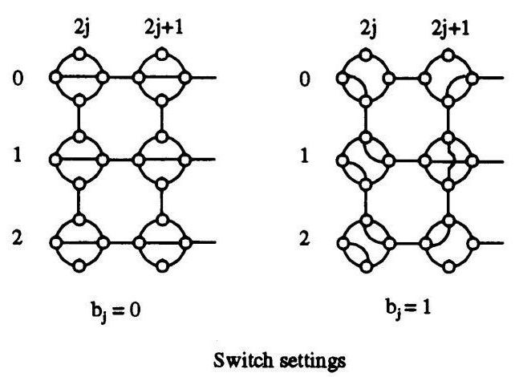
Example: Switch Configuration on XOR Algorithm
n = 3
Mesh size = 2n X 3

Slide 9
Some Reconfigurable Mesh Algorithms
Time` | Mesh Size | Problem
O(1) | 2n X 3 | XOR
O(1) | 1 X n | Prefix-And of n 1-bit numbers
O(1) | n X n | Maximum of n (log n)-bit numbers
O(1) | n X nk | Addition of n k-bit numbers
O(1) | n X n | Multiplication of two n-bit numbers
O(1) | n X n | Division of two n-bit numbers
O(1) | n X n | Sort of n O(log n)- bit numbers
O(1) | n X n | Convex Hull of n points
O(1) | n X n | Smallest enclosing rectangle of n points
O(1) | n² X n | Triangular enclosing of n planar points
O(1) | n X n | All-pairs nearest neighbors of n points
O(log n) | n X n | Connected components of an n X n image
Logic, arithmetic sorting and selection
Graph and image algorithms

Slide 10
Related Work
Currently, the following environments have been developed:
A Simulator for the Reconfigurable Mesh Architecture, 1998
Serial simulation of reconfigurable mesh, an image understanding architecture, 1998
Java Applet to Visualize Algorithms on Reconfigurable Mesh, 2000
ARMLang: A Language and Compiler for Programming Reconfigurable Mesh Many-Cores, 2009

Slide 11
Our Solution
Compiler for the Reconfigurable Mesh Language
Translate the RM Algorithms to runnable code
Working Environment to easy the writing of the RM Algorithms
Text editor
Running simulation
Debugger

Slide 12
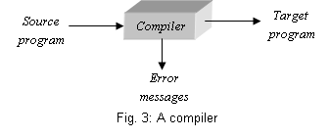
Compiler Design
Compilers for high level programming languages are large, complex software systems
Building a compiler for the RM Algorithms will require:
Defining the language
Writing regular expressions
Writing context-free grammar
Creating a runnable code in C#

Slide 13
Compiler Design
The Front-End of the compiler
Lexical Analyzer
Syntax Analyzer (Parser)
Semantic Analyzer
String of characters
Lexical
analyzer
String of tokens
Parser
Symbol table and
access routing
Abstract syntax tree
Semantic
analyzer
Syntax tree
Code generator
Target code, multi threaded
Fig. 4: High level structure of a simple compiler

Slide 14
Compiler Design
String of characters
The Back-End of the compiler
Code Generator (C#)
Lexical
analyzer
String of tokens
Parser
Symbol table and
access routing
Abstract syntax tree
Semantic
analyzer
Syntax tree
Code generator
Target code, multi threaded
Fig. 4: High level structure of a simple compiler

Slide 15
The Compilation Process
Source code
Characters stream
Lexical Analyzer
Use regular expressions
Token stream
Syntax Analyzer
Use context-free grammar
Abstract syntax tree
Use the RM language semantic
Semantic Analyzer
Syntax tree
Use a C-like program to translate the syntax tree to target code
Code Generator
Target code, multi threaded

Slide 16
Lexical Analyzer
var Mesh m[8][8];
m.r1 = m.r2 + 1;
Lexical Analyzer
'var' 'Mesh' 'identifier' '[' 'integer' ']' '[' 'integer' ']' 'semicolon'
'identifier1' 'assignment statement' 'identifier2' '+' 'integer' 'semicolon'

Slide 17
Syntax Analyzer
'var' 'Mesh' 'identifier' '[' 'integer' ']' '[' 'integer' ']' 'semicolon'
'identifier1' 'assignment statement' 'identifier2' '+' 'integer' 'semicolon'
Syntax Analyzer
Program
variableDeclaration
functionDeclaration
body
var
meshDefinition
registerDefinition
IOvectorDefinition
ε
assignment statement
Mesh
meshIdentifier
meshDimension3
ε
ε
Identifier₁
=
expression
semicolon
m
[
integer
]
meshDimension2
m.r1
Identifier₂
+
integer
8
[
integer
]
meshDimension1
m.r2
1
8
semicolon

Slide 18
Semantic Analyzer
Program
variableDeclaration
functionDeclaration
body
var
meshDefinition
registerDefinition
IOvectorDefinition
ε
assignment statement
Mesh
meshIdentifier
meshDimension3
ε
ε
Identifier₁
=
expression
semicolon
[
integer
m
]
meshDimension2
m.r1
Identifier₂
+
integer
8
[
integer
]
meshDimension1
m.r2
1
8
semicolon
Semantic Analyzer
Continue to code generation

Slide 19
Code Generation
Program
variableDeclaration
functionDeclaration
body
var
meshDefinition
registerDefinition
IOvectorDefinition
ε
assignment statement
Mesh
meshIdentifier
meshDimension3
ε
ε
Identifier₁
=
expression
semicolon
[
integer
m
]
meshDimension2
m.r1
Identifier₂
+
integer
8
[
integer
]
meshDimension1
m.r2
intToBit
8
semicolon
1
Code Generator
Multi threaded code in C#
Mesh file:
Mesh m = new Mesh(8,8);
Processing element file:
r1 = r2 + 1;

Slide 20
The Compilation Process - Example
var:
Logic AND
Var
Mesh m[1][8];
Register r1;
Input x[N];
Output y[1];
Begin R: scan(m,[0,0][0,7][0,1],x,SOUTH);
m.r1=SOUTH;
B: if (m.r1==1) then connect (WEST-EAST); endif
W: Execute(m,[0,0][][],'1',WEST);
if (m.r1 == '0') then m.EAST='0'; endif print(m,[0,N-1][][],y,WEST);
End
R:
X =
1 0 1 0 1 1 0 0
B:
W:
‘1’
‘0’
‘0’
‘0’
‘0’
print:
‘0’

Slide 21
Obstacles
Effective partition and threads management
Effective bus construction
Detecting short-circuit on the bus
Developing language to easy design of high-level algorithms

Slide 22
Benefits and Future Plans
This working environment can be used for testing new algorithms developed for Reconfigurable Mesh
Valuable tool for studying and understanding the behavior of parallel algorithms on the Reconfigurable Mesh
Translating into FPGA components
Expanding the language

Slide 23
References
[1]. H. Giefers and M. Platzner "Realizing Reconfigurable Mesh Algorithms on Softcore Arrays" appears in: "Embedded Computer Systems: Architectures, Modeling, and Simulation, 2008. SAMOS 2008. International Conference on", pp 41-48, July 2008.
[2]. Reisis, D.I. "An efficient convex hull computation on the reconfigurable mesh", Parallel Processing Symposium, 1992. Proceedings, Sixth International, pp 142-145.
[3]. K. Miyashita and R. Hashimoto, "A Java Applet to Visualize Algorithms on Reconfigurable Mesh", in Proc. of the 15th Workshops on Parallel and Distributed Processing, IPDPS ’00, 2000, pp. 137–142.
[4]. K.C. Louden, "Compiler construction, principles and practice", PWS Publishing Company, pp 1-2, 31-138,1997.
[5]. Y. Ben-Asher and E. Stein, "Basic Algorithms for the Asynchronous Reconfigurable Mesh", VLSI Design Volume 15 (2002), Issue 1, Pages 441-454.
[6]. R. Wilhelm & D. Maurer, "Compiler Design", Wokingham, UK: Addison Wesley, pp 222 – 233, 1995.
[7]. S. Muchnick, "Advanced compiler design and implementation", San Francisco, CA : Morgan Kaufmann, pp 1-3, 1997.
[8]. C. Steckel, M. Middendorf, H. ElGindy and H. Schmeck, "A Simulator for the Reconfigurable Mesh Architecture", "Parallel & Distributed Processing", pp 99-104, 1998.
[9]. M. Murshed and R. Brent, “Serial simulation of reconfigurable mesh, an image understanding architecture”, Advances in Computer Cybernetics, vol. 5, pp. 92–97, 1998.
[10]. H. Giefers and M. Platzner, "ARMLang: A Language and Compiler for Programming Reconfigurable Mesh Many-Cores", Parallel and Distributed Processing Symposium, International pp. 1-8, 2009 IEEE International Symposium on Parallel&Distributed Processing, 2009.

Slide 24
ANNEXE I - Example of Algorithm in RM Language
Left Most Determine
Var
Mesh m[1][N];
Register r1, r2;
Input x[N];
Output y[1];
Begin R: scan(m, [0,0][0,N-1][0,1], x, SOUTH);
m.r1=South;
B: if (m.r1==0) then
connect (WEST-EAST);
endif
W: execute(m, [0,0][][],'0',WEST);
if (m.r1 == '1') then m.EAST = '1'; endif
R: if (m.r1 == 1) then
m.r2=WEST;
if (m.r2 == 0)
NORTH = '1';
else NORTH = '0'
endif
endif
print(m, [0,0][0,N-1][0,1], y, NORTH);
pst(y);
End

Slide 25
ANNEXE II Language Definition
Var
Mesh <name>[D1][D2][D3]; register<name>,<name>,…,<name>; Input <name>[D1]; Output <name>[D1];
Program
scan(<to>,[<start_D1>,<start_D2,<start_D3>][<end_D1>,<end_D2,<end_D3>][<jump_D1>,<jump_D2>,<jump_D3>], <from>,<Direction>);
print(<from>,[<start_D1>,<start_D2,<start_D3>][<end_D1>,<end_D2,<end_D3>][<jump_D1>,<jump_D2>,<jump_D3>], <to>,<Direction>);
execute(<to>,[<start_D1>,<start_D2,<start_D3>][<end_D1>,<end_D2,<end_D3>][<jump_D1>,<jump_D2>,<jump_D3>], <from>,<Direction>);
assign value to register: <mesh_name>.<regname>=<direction>; // note: The value will be assign to the all Mesh.
<mesh_name>[D1][D2][D3].<regname>=<direction>; // note : the value will be assigned to the dimension according to the number of dimensions
assign value to Direction:
<mesh_name>.<Direction> = <register_name>| <value>; <mesh_name>[D1][D2][D3].<direction>=<register_name>| <value>;
Special Assist Function;
1UN(< Output_vector >) – sum the '1' in the Output Vector.
2UN(< Output_vector >) – sum the joined (to the left) '1' in the Output Vector.
BIN(< Output_vector >) – Decimal representation of the Output Vector.
PST(< Output_vector >) – Returns the location of the singular '1' in the Output vector.

Slide 26
ANNEXE III The RM language BNF / production rules for the syntax analyzer
Program ⇒ variableDeclaration functionDeclaration Body variableDeclaration ⇒ "Var" meshDefinition registerDefinition IOvectorDefinition meshDefinition ⇒ "Mesh" meshIdentifier meshDimension3 meshDimension3 ⇒ "[" Integer "]" meshDimension2 meshDimension2 ⇒ "[" Integer "]" meshDimension1 | meshDimension1 meshDimension ⇒ "[" Integer "]" semicolon | semicolon registerDeclaration ⇒ "Register" identifiers identifiers ⇒ registerIdentifier nextIdentifier nextIdentifier ⇒ "," registerIdentifier nextIdentifier | semicolon
meshIdentifier ⇒ id
registerIdentifier ⇒ id
value ⇒ Number | registerIdentifier

Slide 27
ANNEXE III The RM language BNF / production rules for the syntax analyzer
Body ⇒ "Program Begin" Step Functions "End" Step ⇒ newline readPhase Block newline calculatePhase Block newline busPhase Block newline writePhase Block | newline readPhase Block newline calculatePhase Block newline busPhase Block newline writePhase Block Step readPhase ⇒ "R" ":" calculatePhase ⇒ "C" ":" busPhase ⇒ "B" ":" writePhase ⇒ "W" ":" connectionConfiguration ⇒ "Connect" "(" switchConfiguration nextConfiguration ")" nextConfiguration ⇒ "," nextConfiguration | switchConfiguration | semicolon switchConfiguration ⇒ "VOID" | "NORTH-SOUTH" | "WEST-EAST" | "NORTH-WEST" | "NORTH-EAST" | "SOUTH-EAST" | "SOUTH-WEST" | "NORTH-WEST-SOUTH" | "NORTH-WEST-EAST" | "NORTH-EAST-SOUTH" | "EAST-SOUTH-WEST"| "NORTH-SOUTH-WEST-EAST" | "N0RTH" | "SOUTH" | "WEST" | "EAST"

Slide 28
ANNEXE III The RM language BNF / production rules for the syntax analyzer
basicDirection ⇒ | "N0RTH" | "SOUTH" | "WEST" | "EAST"
Block ⇒ statement | statement nextStatament
nextStatement ⇒
statament ⇒ scanStatement | printStatement |executeStatement | assignRegisterStatement | assingDirectionStatement | connectionConfiguration
scanStatement ⇒"scan" "(" id "," algorithmCoordinates "," id "," switchConfiguration ")" semicolon
printStatement ⇒"print" "(" id "," algorithmCoordinates "," id "," switchConfiguration ")" semicolon
executeStatement ⇒"execute" "(" id "," algorithmCoordinates "," id "," switchConfiguration ")" semicolon
assingRegisterStatement ⇒ meshIndentefier Dimention "."registerndetefire "=" basicDirection semicolon
assingDirectionStatement ⇒ meshIndentefier Dimention "." switchConfiguration "=" value semicolon
algorithmCoordinates⇒ startCoordinates endCoordinates jumpCoordinates semicolon
StartCoordinates ⇒ Dim "," Dim | Dim "," Dim "," Dim endCoordinates ⇒ Dim "," Dim | Dim "," Dim "," Dim jumpCoordinates ⇒ Dim "," Dim | Dim "," Dim "," Dim Dim ⇒ "["Integer "]"

Slide 29
Use Case

Slide 30
Basic Data Structure

